Slide 1

WB
Whistleblower Sea. Ctr. 5/20/2015

Slide 2
THE NEW WHISTLEBLOWER
PROTECTION CODE

Slide 3
How many US workers say they have observed workplace misconduct? (30)
About two-thirds.
About one-half.
About one-fourth.
About one-tenth.

Slide 4
Of those, how many SAY THEY reported it? (30)
About two-thirds.
About one-half.
About one-fourth.
About one-tenth.

Slide 5
REASONS FOR NOT REPORTING
Why would an employee
not report misconduct?

Slide 6
Reasons for NOT Reporting (10 each)
A. Nothing will be done.
B. Fear retaliation.
C. Fear being identified.
D. Someone else will report.
(More than one response allowed)

Slide 7
Reasons for NOT Reporting
Nothing will be done. 59 %
Fear retaliation. 46 %
Fear being identified. 39 %
Someone else will report. 24 %
(More than one response allowed)

Slide 8
Of those who did report, how many say they DID experience retaliation?
About two-thirds.
About one-half.
About one-fourth.
About one-tenth.

Slide 9
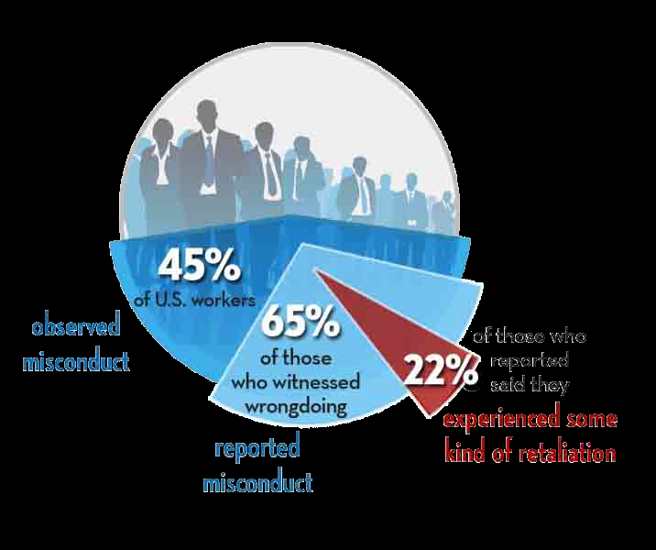
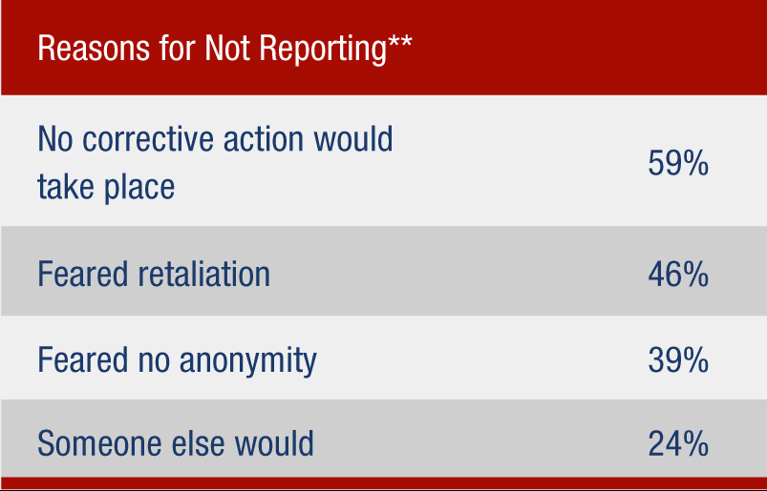
Why Would An Employee Not Report Wrongdoing?
Any WB law includes two parts:
Report Wrongdoing:
See something? Say something!
Retaliation:
Avoid it/Correct it.

Slide 10
Two parts of ANY WB Law
Report wrongdoing (See something? Say something!)
Prevent retaliation.

Slide 11
Reporting
Retaliation
Retaliation
To Whom?
What?
What is it?
How?
When?
Retaliation
Investigations
IGA
Investigations
Who?
Results?
Who?
Results?

Slide 12
NEW Whistleblower Protection
Reporting
within department OR
to the SEEC.
Protected from Retaliation for;
reporting OR
being a witness.
SEEC conducts independent investigations of WB retaliation complaints.

Slide 13
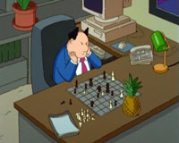
What Is Covered? (3 pts each) Improper Governmental Actions Whistleblower Code? (10 EACH)
Violations of Law?
Safety Threats?
Gross Waste?
Poor management decisions?
Personnel matters?

Slide 14
Reporting – 7
Ann thinks her supervisor regularly accepts free tickets from promoters she is in charge of negotiating Center contracts with.
Covered by WB ordinance?

Slide 15
WB – 7
Kiesha sees what she thinks is a dangerous mistake in some staging being erected for a show. Her supervisor says don’t worry about it. She wants to say something to her manager.
Covered by WB?

Slide 16
WB – 7
Joe thinks the City’s program to buy materials from small businesses is a waste of money because the materials often cost more. He complains to his supervisor.
Covered by WB?

Slide 17
WB – 7
Tom gets a 3 day suspension for being late to work. He thinks his department has not followed progressive discipline.
Is this type of issue covered by the WB ordinance?

Slide 18
Reporting – 3 each
Where can Ann
go for advice?
Her manager/director?
Her Dept. HR group?
SDHR? The SEEC?

Slide 19
Reporting – 7
Can Ann report
anonymously?
To her Dept.?
To the Ethics Office?

Slide 20
Retaliation – 7
Is Ann protected
from retaliation if she reports
w/in her dept?
To the Ethics Office?

Slide 21
Retaliation
Ann’s manger
looks into the Ethics
situation and gets back to her.
Her supervisor was
occasionally on E-bay but was
not running an E-Bay
business at work.

Slide 22
Retaliation - 7
Is Ann still protected
from retaliation even though
she was mistaken about
an Ethics Code violation?

Slide 23
Retaliation -
A few weeks later,
Ann’s supervisor gives her a
negative performance evaluation.

Slide 24
Retaliation - 7
Is that retaliation?
What do we need to
know to decide if it was
retaliation or not?

Slide 25
Retaliation -
If the SEEC investigates
and finds retaliation,
they can ask the
Hearing Examiner
to order the dept.
to correct it.

Slide 26
Retaliation – 7
If
the Hearing Examiner
finds retaliation,
what can she do about it?
Remove a bad eval.?
Order reinstatement? Back pay?
The next promotion?

Slide 27
POST GAME WRAPUP
What should I do if I have
a question about
the Ethics Code or
Whistleblower Code?

Slide 28
POST GAME WRAPUP
If I ask the SEEC for advice, can they later decide I violated the Code even if I followed their advice?

Slide 29
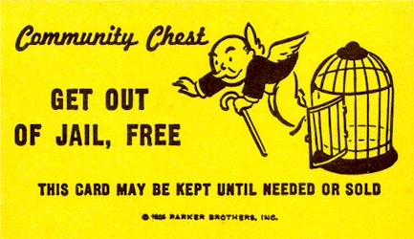

Slide 30
POST GAME WRAPUP
Can the Ethics Commission fire
someone who violates
the Ethics Code?
Retaliates against a Whistleblower?
Can they fine a violator?

Slide 31
When in Doubt…. Give a Shout

